Slide 1
MongoDB

Slide 2
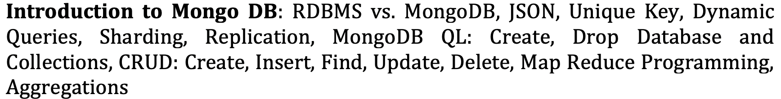
Syllabus

Slide 3
Name comes from “Humongous” & huge data
Written in C++, JavaScript, Python developed in 2009
Creator: 10gen software company , (former doublick) as a component of a planned platform as a service product

Slide 4
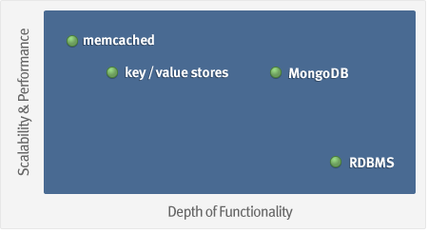
MongoDB: Goal
Goal: bridge the gap between key-value stores (which are fast and scalable) and relational databases (which have rich functionality).

Slide 5
What is MongoDB ?
Defination: MongoDB is an open source, document-oriented database designed with both scalability and developer agility in mind.
Instead of storing your data in tables and rows as you would with a relational database, in MongoDB you store JSON-like documents with dynamic schemas (schema-free, schemaless).

Slide 6
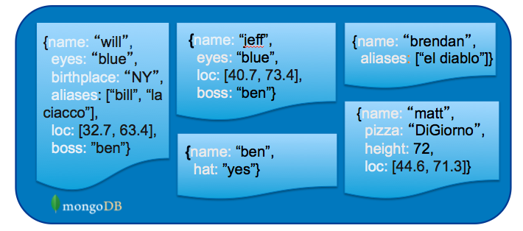
What is MongoDB? (Cont’d)
Document-Oriented DB
Unit object is a document instead of a row (tuple) in relational DBs

Slide 7
Document store
RDBMS |  | MongoDB
Database |  | Database
Table, View |  | Collection
Row |  | Document (JSON, BSON)
Column |  | Field
Index |  | Index
Join |  | Embedded Document
Foreign Key |  | Reference
Partition |  | Sharding
> db.user.findOne({age:39})
{
"_id" : ObjectId("5114e0bd42…"),
"first" : "John",
"last" : "Doe",
"age" : 39,
"interests" : [
"Reading",
"Mountain Biking ]
"favorites": {
"color": "Blue",
"sport": "Soccer"}
}
Notes:
Flexible schema
Javascript

Slide 8
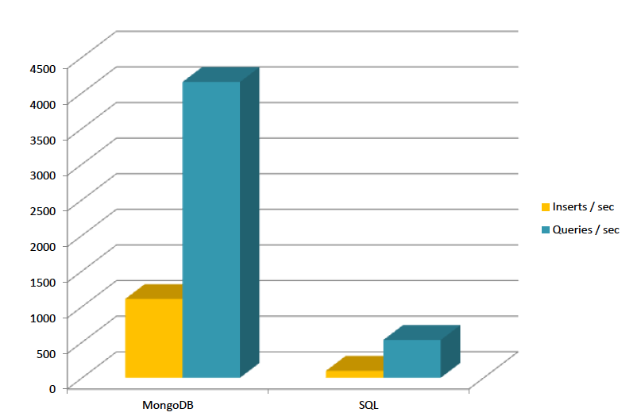
Is It Fast?
For semi-structured & complex relationships: Yes

Slide 9
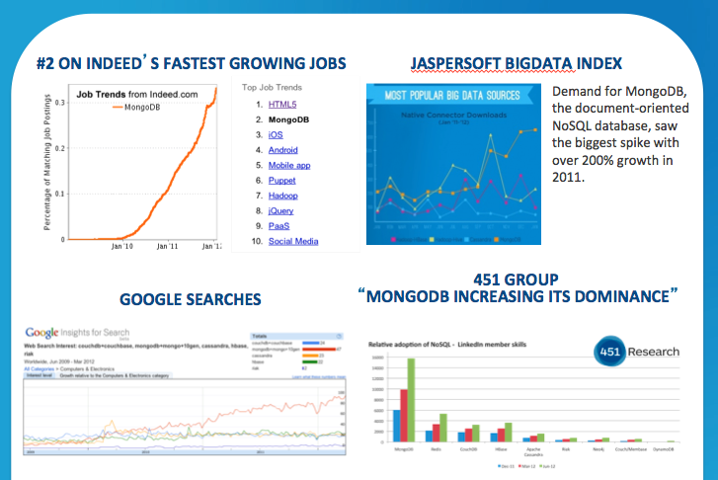
It is Growing Fast

Slide 10
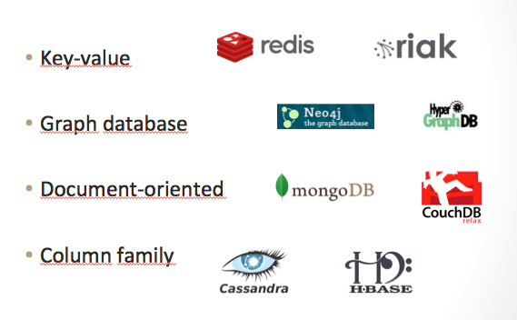
NoSQL: Categories

Slide 11
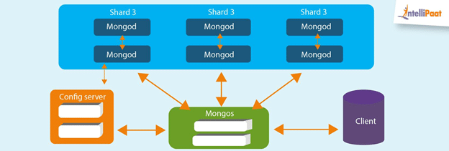
Architecture of MongoDB NoSQL Database

Slide 12

Important MongoDB Features

Slide 13
Important MongoDB Features
Queries: It supports ad-hoc queries and document-based queries.
Index Support: Any field in the document can be indexed.
Replication: It supports Master-Slave replication.
Multiple Servers: The database can run over multiple servers. Data is duplicated to foolproof the system in the case of hardware failure.
Auto-sharding: This process distributes data across multiple physical partitions called shards. Due to sharding, MongoDB has an automatic load balancing feature.
MapReduce: It supports MapReduce and flexible aggregation tools.
Failure Handling: Huge numbers of replicas give out increased protection and data availability against database downtimes like rack failures, multiple machine failures, and data center failures, or even network partitions.
GridFS: Without complicating your stack, any size of files can be stored. GridFS feature divides files into smaller parts and stores them as separate documents.
Schema-less Database: It is a schema-less database written in C++.
Document-oriented Storage: It uses the BSON format which is a JSON-like format.

Slide 14
Data Model

Slide 15
Data Model
BSON format (binary JSON)
Developers can easily map to modern object-oriented languages without a complicated ORM layer.
lightweight, traversable, efficient

Slide 16
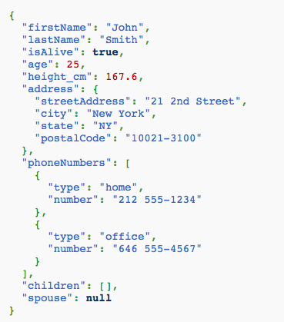
JSON
Field Name
Field Value
Field Value
Scalar (Int, Boolean, String, Date, …)
Document (Embedding or Nesting)
Array of JSON objects
One document

Slide 17
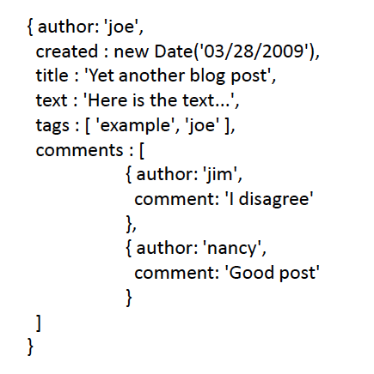
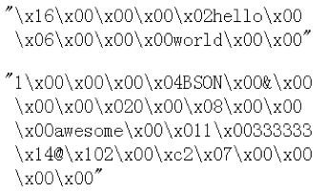
Another Example
Remember it is stored in binary formats (BSON)

Slide 18
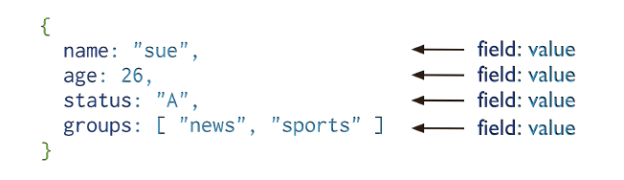
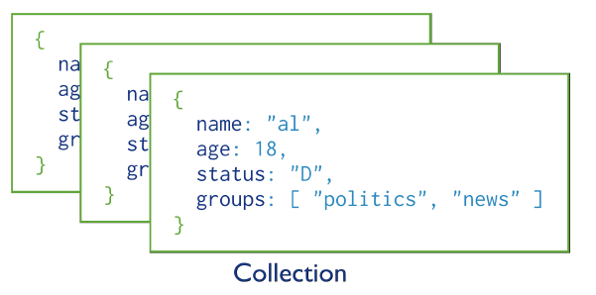
MongoDB Model
One document (e.g., one tuple in RDBMS)
Collection is a group of similar documents
Within a collection, each document must have a unique Id
One Collection (e.g., one Table in RDBMS)
Unlike RDBMS:
No Integrity Constraints in MongoDB

Slide 19
MongoDB Model
One document (e.g., one tuple in RDBMS)
The field names cannot start with the $ character
The field names cannot contain the . character
Max size of single document 16MB
One Collection (e.g., one Table in RDBMS)

Slide 20
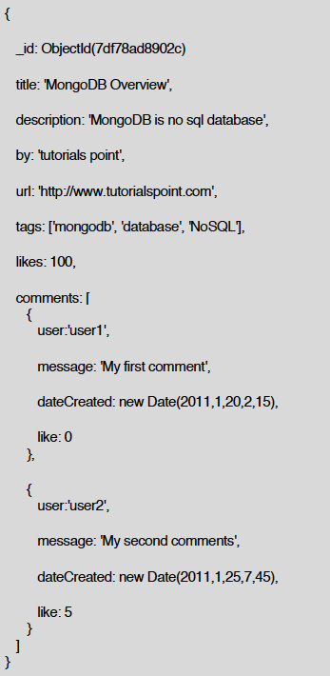
Example Document in MongoDB
_id is a special column in each document
Unique within each collection
_id ⬅➔ Primary Key in RDBMS
_id is 12 Bytes, you can set it yourself
Or:
1st 4 bytes ➔ timestamp
Next 3 bytes ➔ machine id
Next 2 bytes ➔ Process id
Last 3 bytes ➔ incremental values

Slide 21
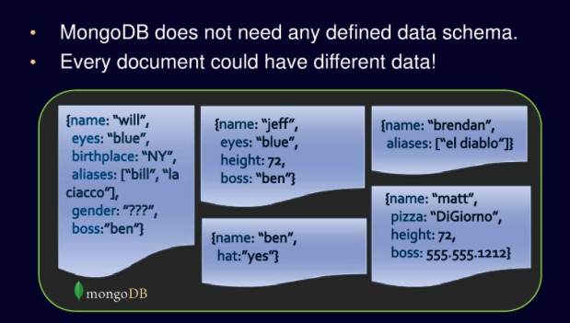
No Defined Schema (Schema-free Or Schema-less)

Slide 22
Data Model Comparison Relational DB vs. NoSQL

Slide 23
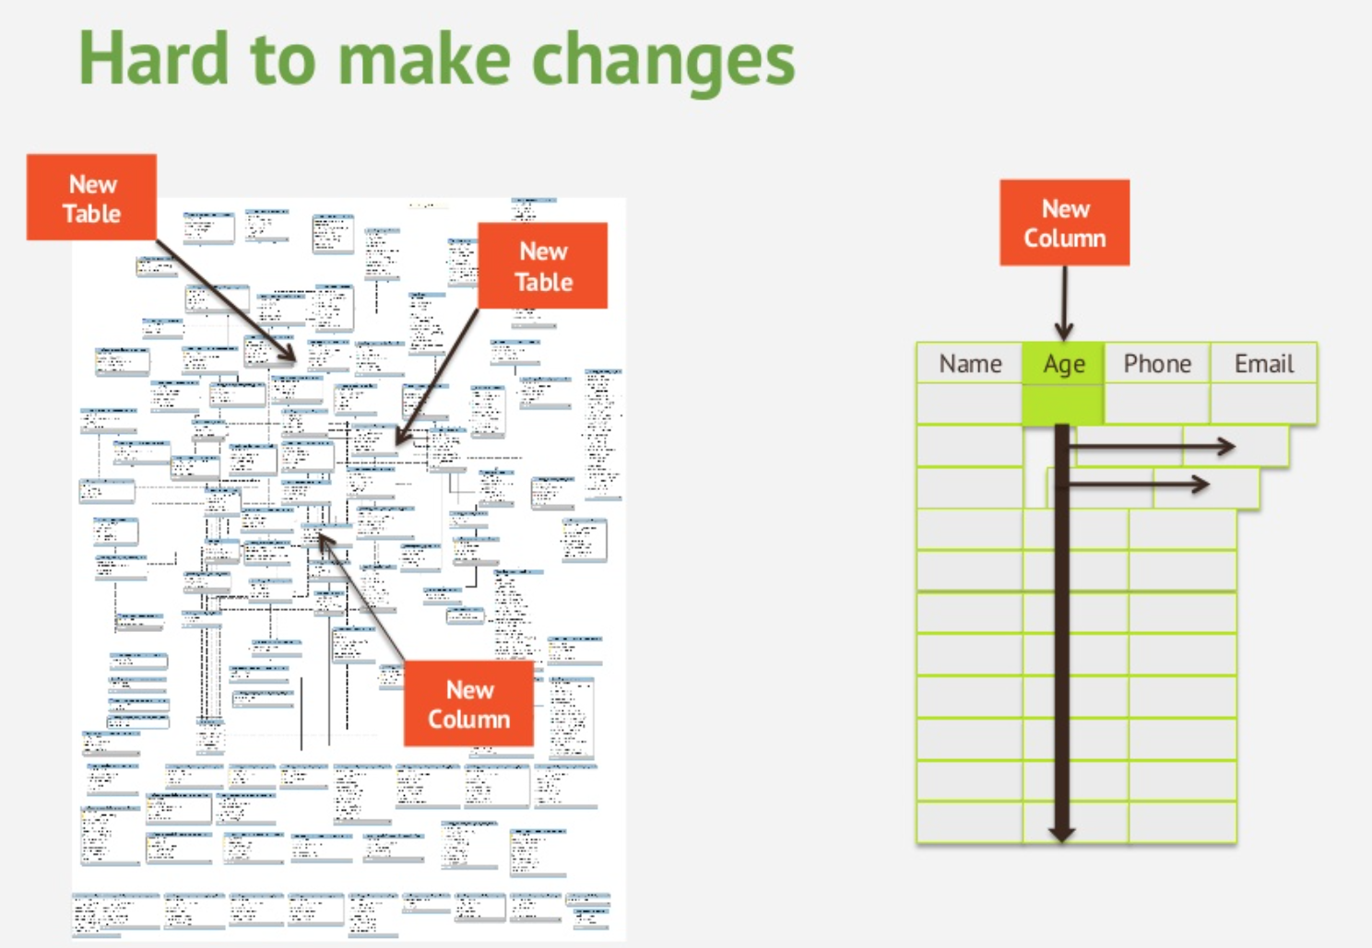

Slide 24
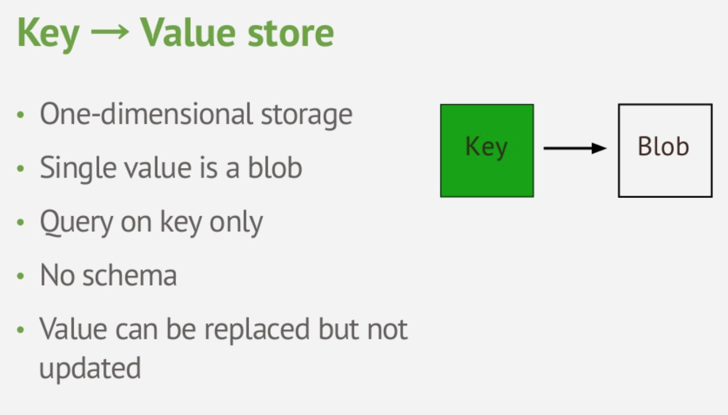
Key-Value Data Model

Slide 25
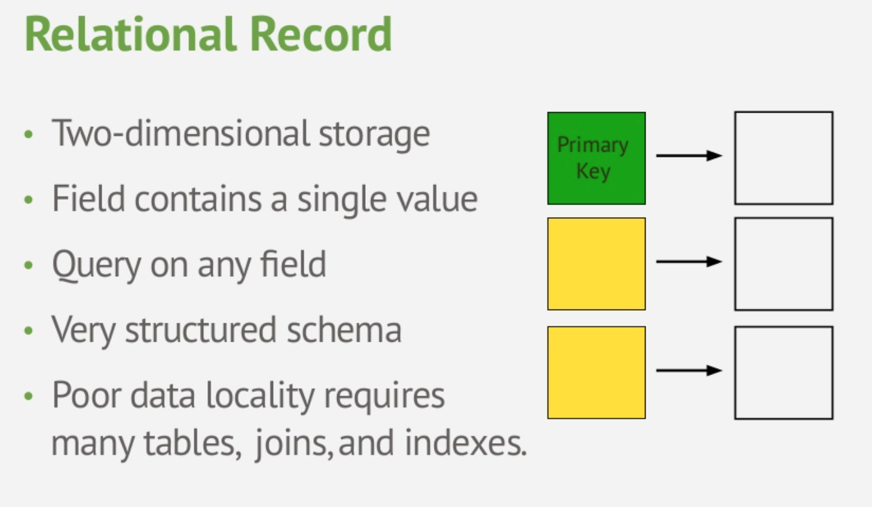
Relational Data Model

Slide 26
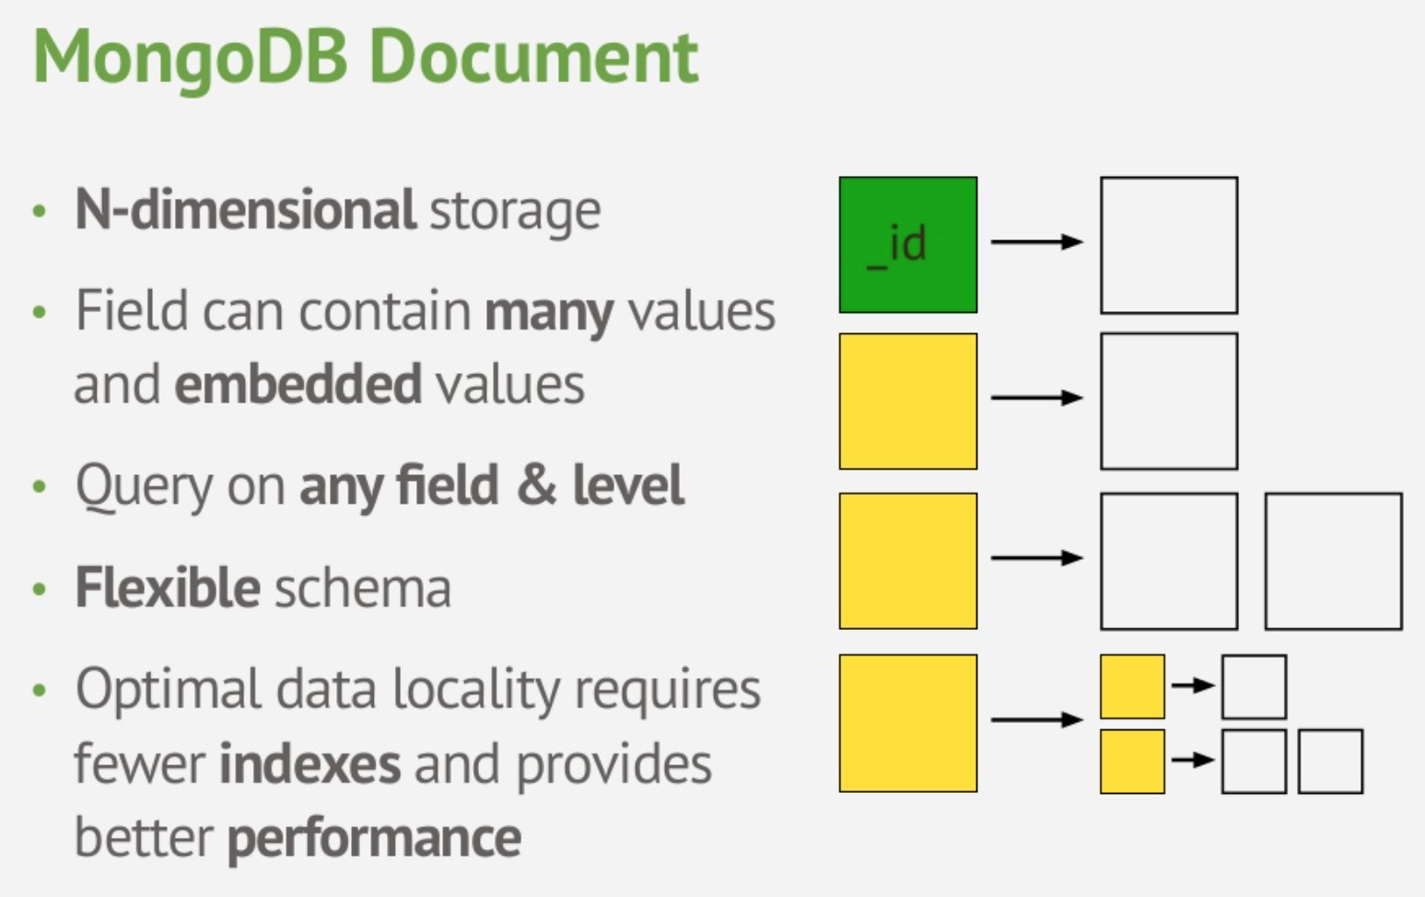
Document Data Model

Slide 27
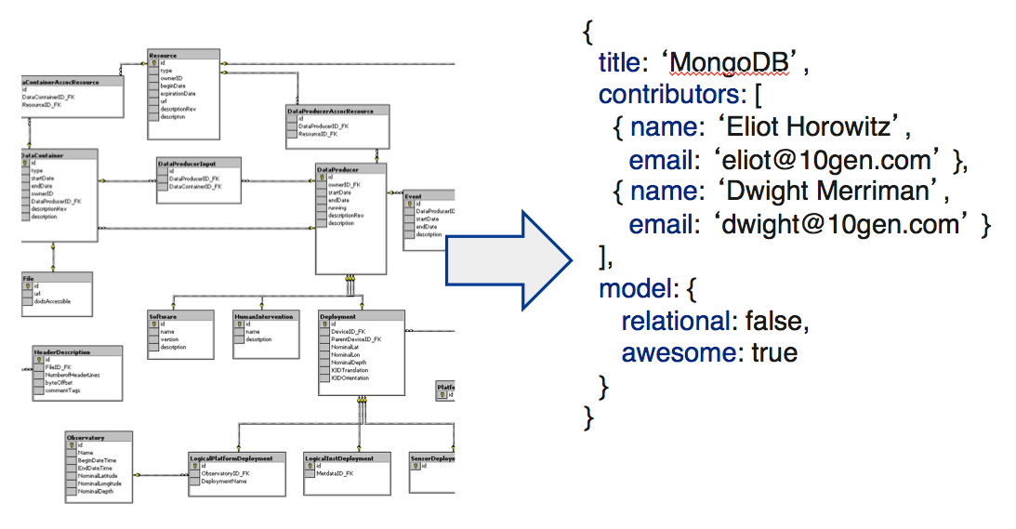
Tradeoff: Normalization vs. Easy Usage

Slide 28
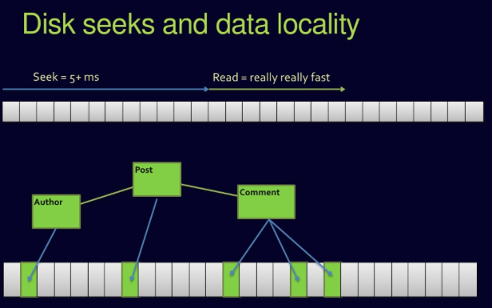
Complex Join Queries
Relational DBs

Slide 29
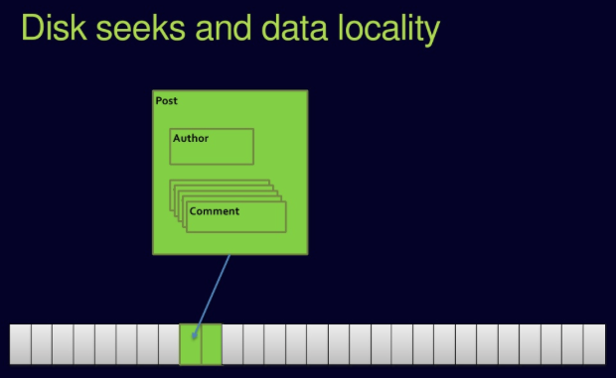
No Joins in MongoDB

Slide 30
Updates & Querying

Slide 31



Must Practice It
Install it
Practice simple stuff
Move to complex stuff
Install it from here: http://www.mongodb.org
Manual: http://docs.mongodb.org/master/MongoDB-manual.pdf
(Focus on Ch. 3, 4 for now)
Dataset: http://docs.mongodb.org/manual/reference/bios-example-collection/

Slide 32
CRUD
Create
db.collection.insert( <document> )
db.collection.save( <document> )
db.collection.update( <query>, <update>, { upsert: true } )
Read
db.collection.find( <query>, <projection> )
db.collection.findOne( <query>, <projection> )
Update
db.collection.update( <query>, <update>, <options> )
Delete
db.collection.remove( <query>, <justOne> )

Slide 33
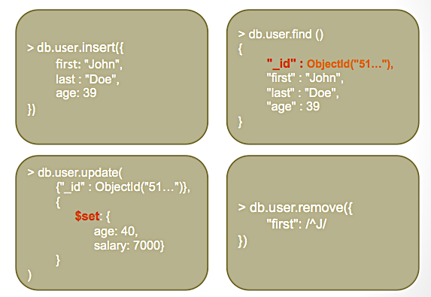
CRUD Examples

Slide 34
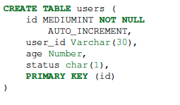
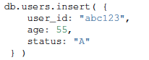

Examples
In RDBMS
In MongoDB
Either insert the 1st docuement
Or create “Users” collection explicitly

Slide 35
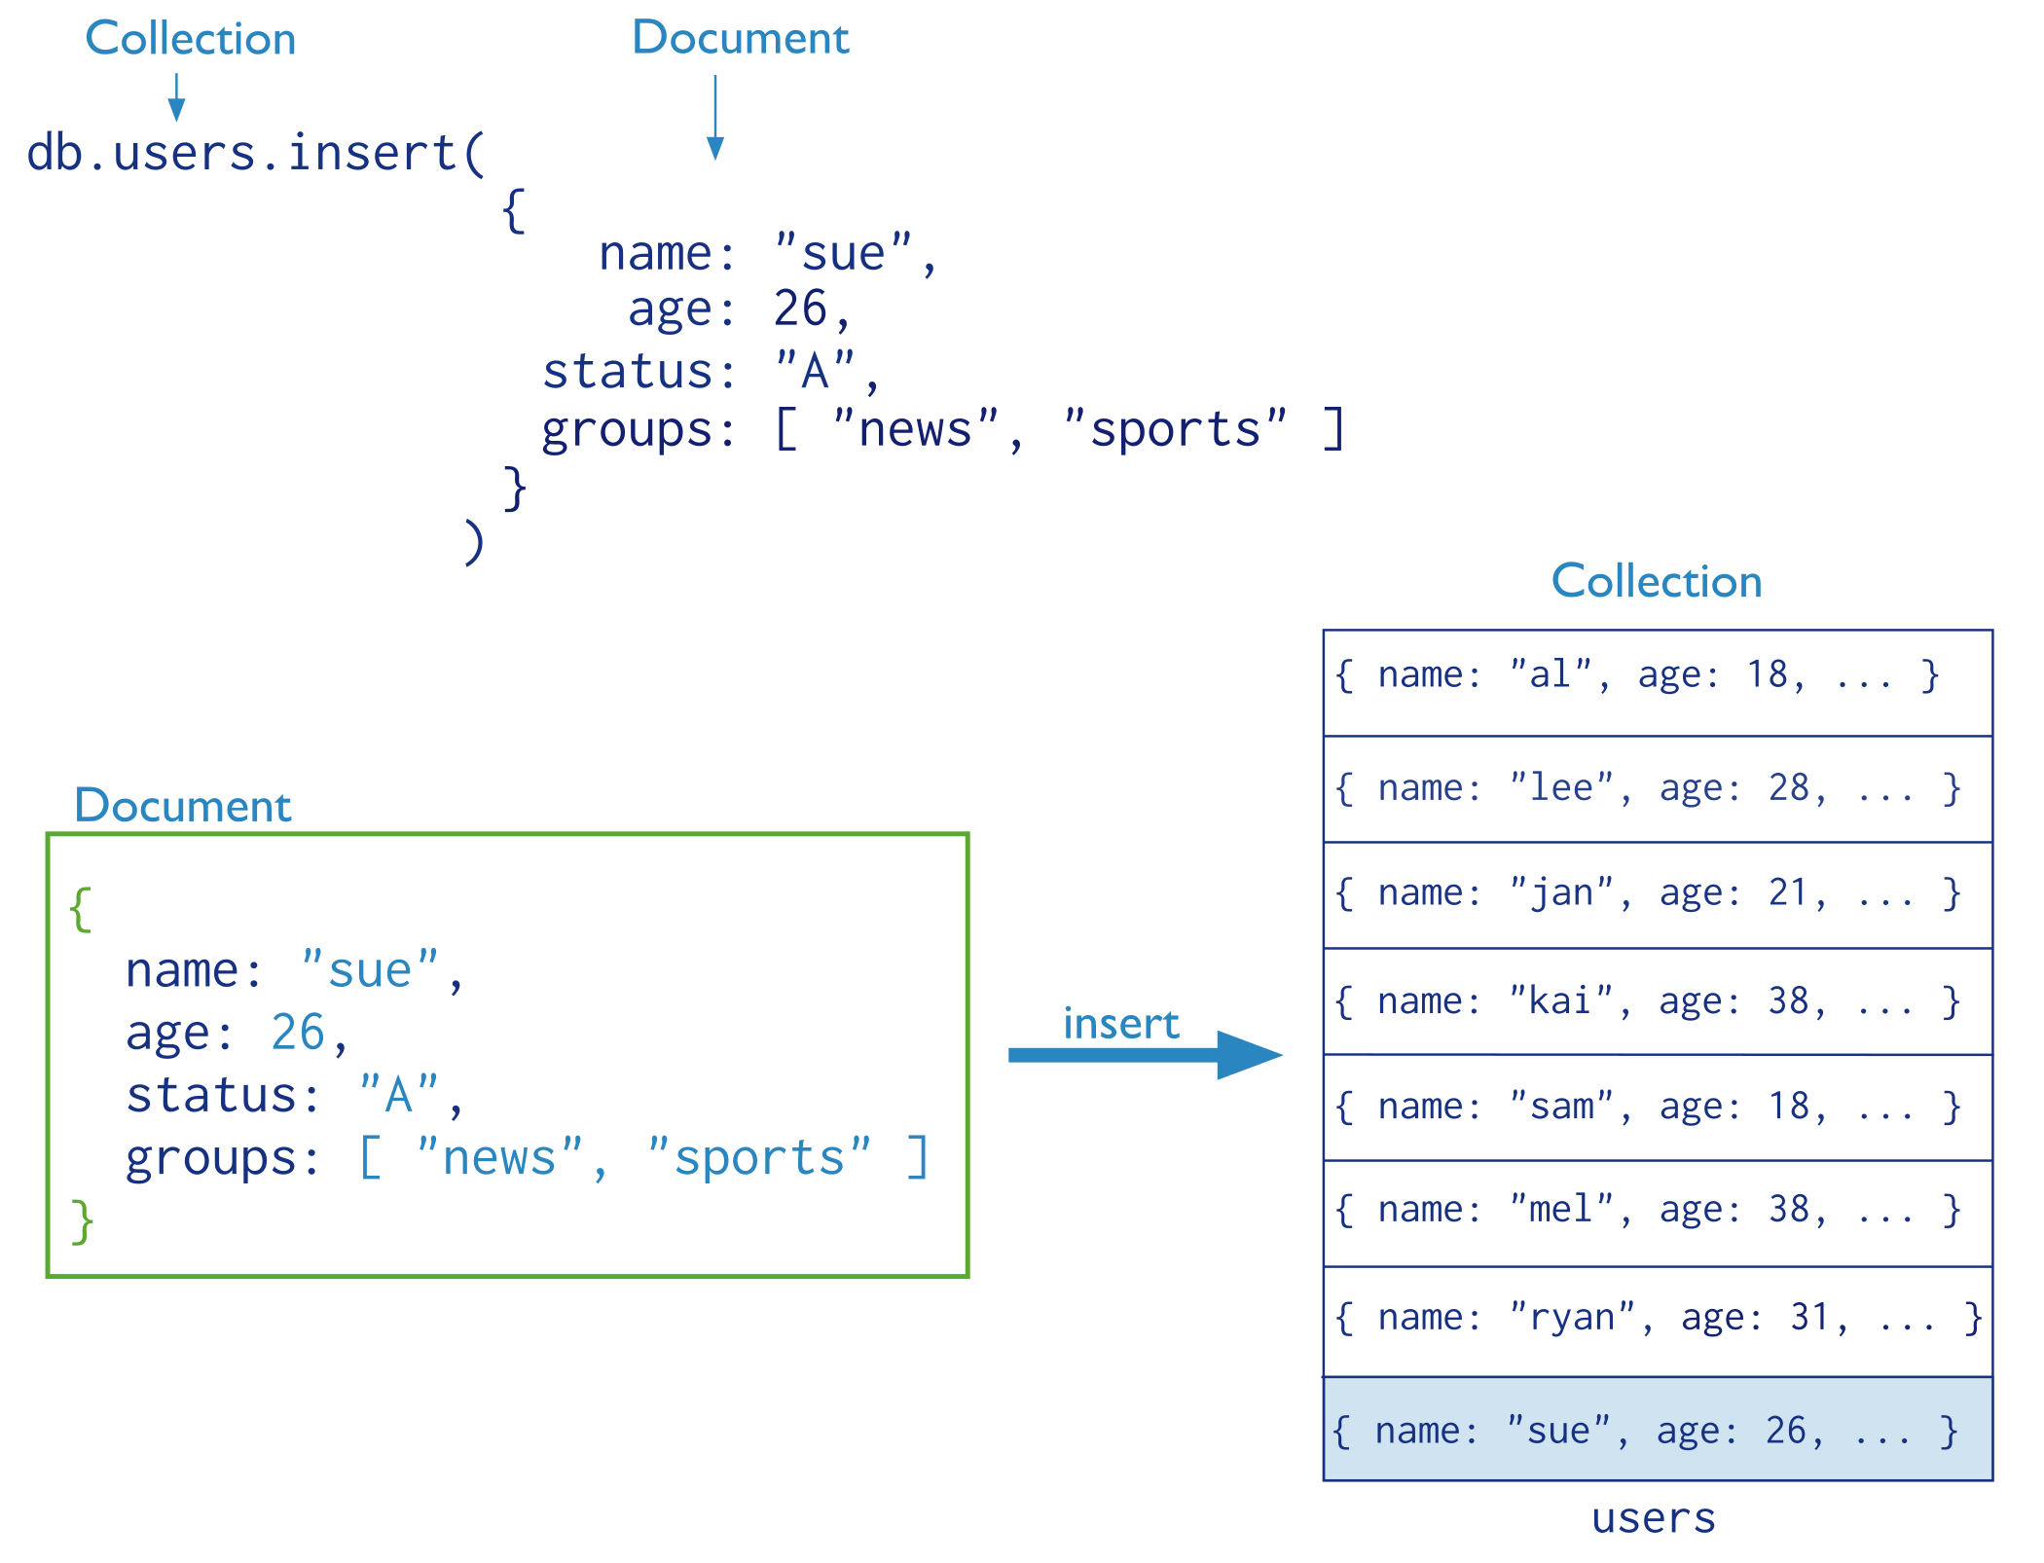
Insertion
The collection “users” is created automatically if it does not exist

Slide 36
Multi-Document Insertion (Use of Arrays)
All the documents are inserted at once

Slide 37
Multi-Document Insertion (Bulk Operation)
A temporary object in memory
Holds your insertions and uploads them at once
There is also Bulk Ordered object
_id column is added automatically

Slide 38
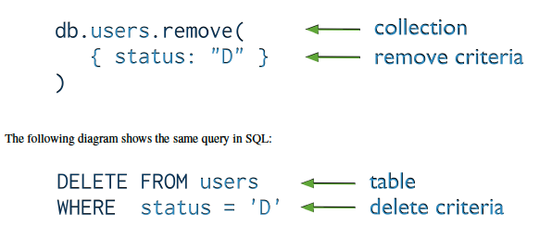
Deletion (Remove Operation)
You can put condition on any field in the document (even _id)
db.users.remove ( )
Removes all documents from users collection

Slide 39
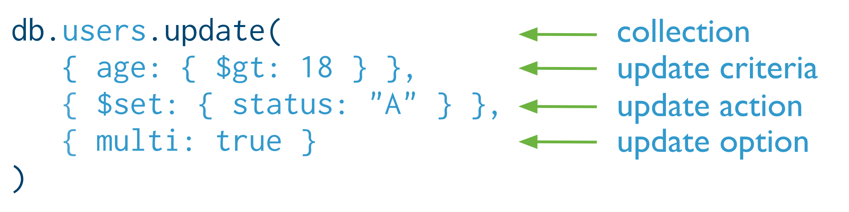

Update
Otherwise, it will update only the 1st matching document
Equivalent to in SQL:

Slide 40
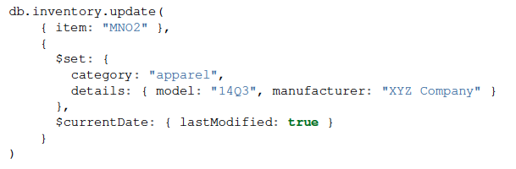
Update (Cont’d)
Two operators

Slide 41
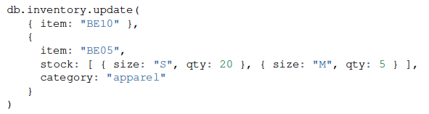
Replace a document
Query Condition
New
doc
For the document having item = “BE10”, replace it with the given document

Slide 42
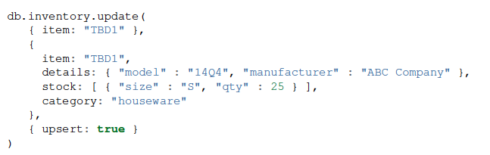
Insert or Replace
The upsert option
If the document having item = “TBD1” is in the DB, it will be replaced
Otherwise, it will be inserted.

Slide 43
Sharding in Mongo DB
Specify a maxSize when you have machines with different disk capacities, or if you want to limit the amount of data on some shards.
Sharding is a method for distributing data across multiple machines.
The maxSize constraint prevents the balancer from migrating chunks to the shard when the totalSize returned from running listDatabases on the shard exceeds the value of maxSize.
Balancer: An internal MongoDB process that runs in the context of a sharded cluster and manages the migration of chunks.

Slide 44
Basic of Sharding
In MongoDB, a sharded cluster consists of:
Shards
Mongos
Config servers
Primary Shard: Each database in a sharded cluster has a primary shard that holds all the un-sharded collections for that database. Each database has its own primary shard.
Source: https://www.mongodb.com/basics/sharding

Slide 45
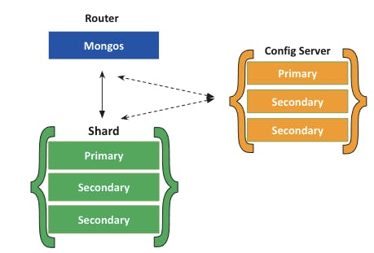
Sharding Architecture

Slide 46
Primary & Secondary Shards
To change the primary shard for a database, use the movePrimary command.
The process of migrating the primary shard may take significant time to complete, and you should not access the collections associated to the database until it completes.
Depending on the amount of data being migrated, the migration may affect overall cluster operations. Consider the impact to cluster operations and network load before attempting to change the primary shard.

Slide 47
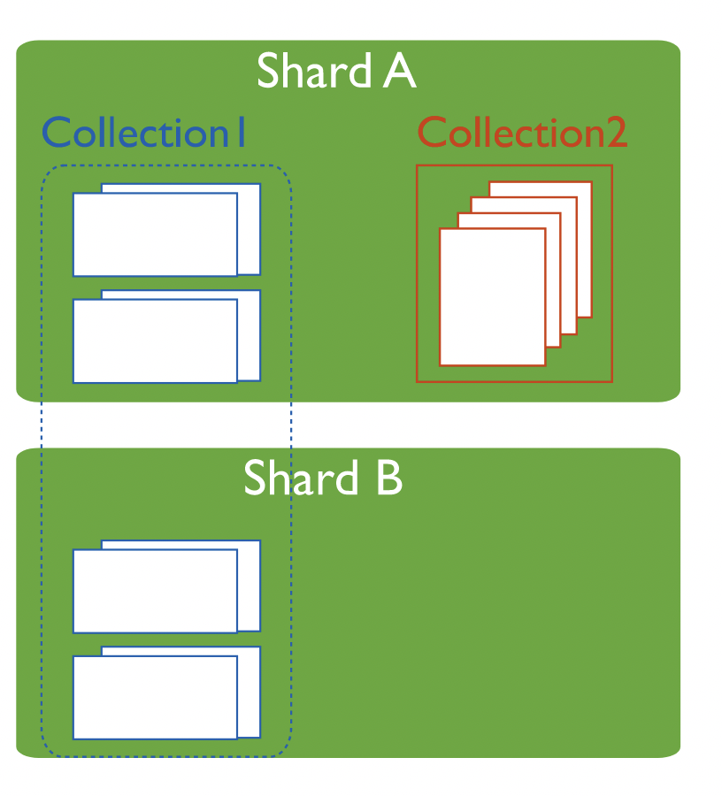

Slide 48
Sharded Cluster
A MongoDB sharded cluster consists of the following components:
shard: Each shard contains a subset of the sharded data. Each shard can be deployed as a replica set.
mongos: The mongos acts as a query router, providing an interface between client applications and the sharded cluster. Starting in MongoDB 4.4, mongos can support to minimize latencies.
config servers: Config servers store metadata and configuration settings for the cluster.

Slide 49
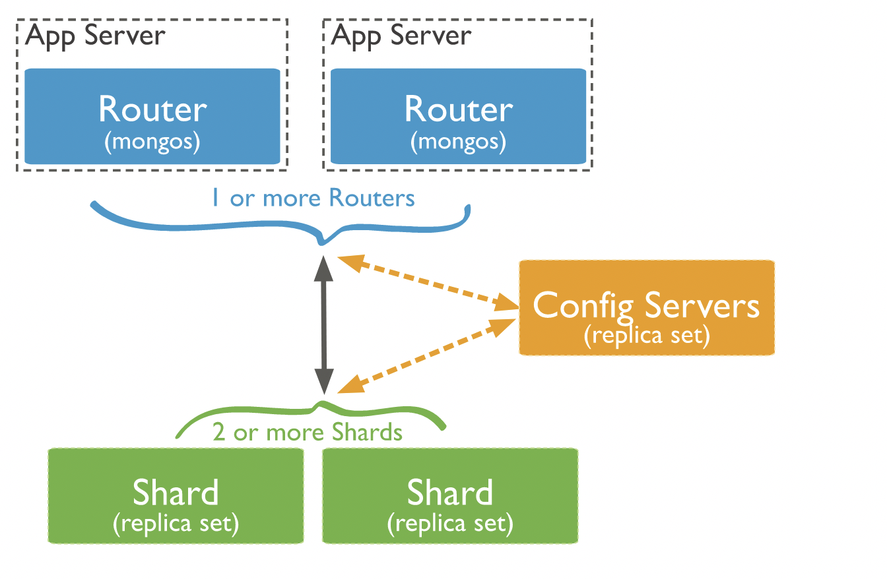
Sharded Cluster
Source: https://www.mongodb.com/docs/upcoming/sharding/

Slide 50
Sharded Cluster
Shard Key Index: To shard a populated collection, the collection must have an index that starts with the shard key.
When sharding an empty collection, MongoDB creates the supporting index if the collection does not already have an appropriate index for the specified shard key.

Slide 51
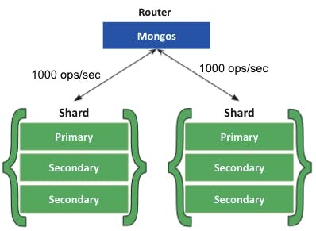
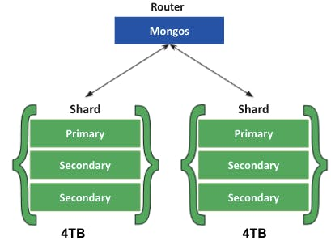
Advantages of Sharding
Increased Throughput.
Storage Capacity
High Availability

Slide 52
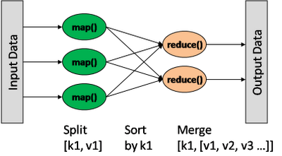
Map/Reduce
db.collection.mapReduce(
<mapfunction>,
<reducefunction>,
{
out: <collection>,
query: <>,
sort: <>,
limit: <number>,
finalize: <function>,
scope: <>,
jsMode: <boolean>,
verbose: <boolean>
}
)
var mapFunction1 = function() { emit(this.cust_id, this.price); };
var reduceFunction1 = function(keyCustId, valuesPrices)
{ return sum(valuesPrices); };
Notes:
http://docs.mongodb.org/manual/reference/method/db.collection.mapReduce/#db.collection.mapReduce

